Slide 1
Hibernate CODES and OUPUT SNIPPETS

Slide 2
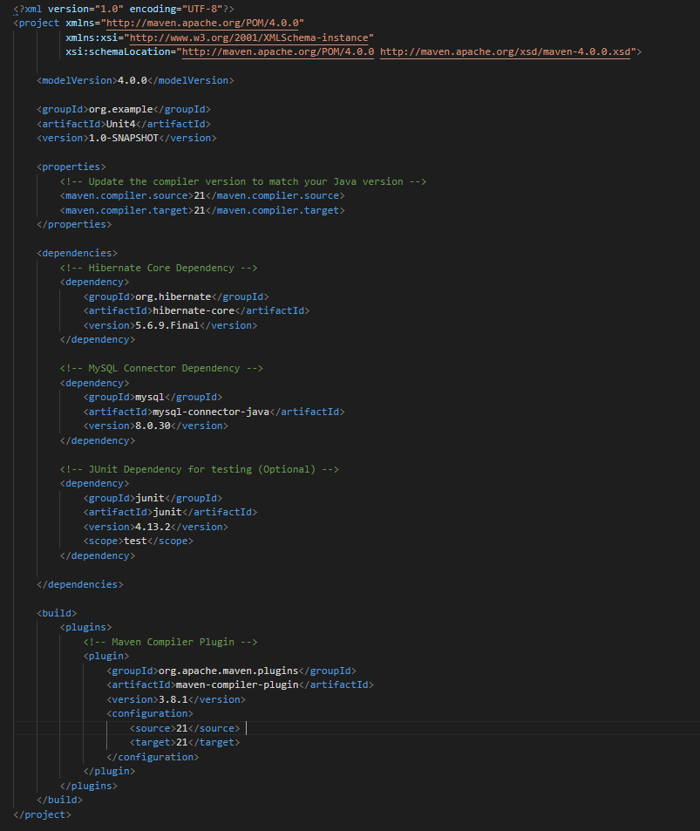
(pom.xml)

Slide 3
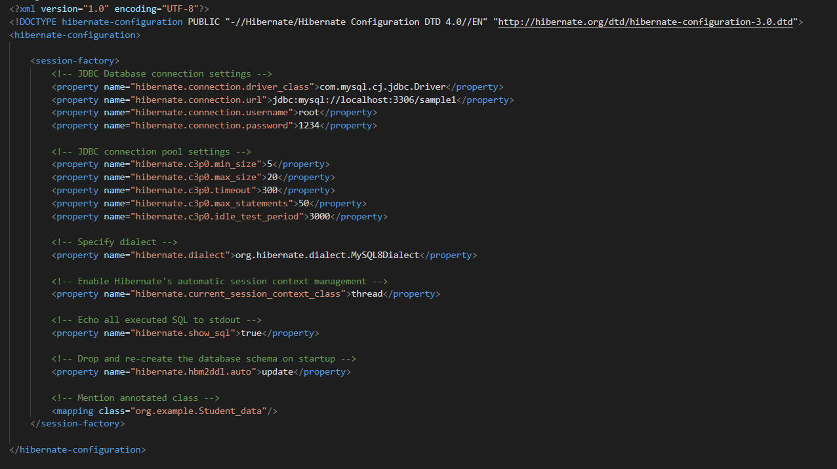
(Hibernate.cfg.xml)

Slide 4
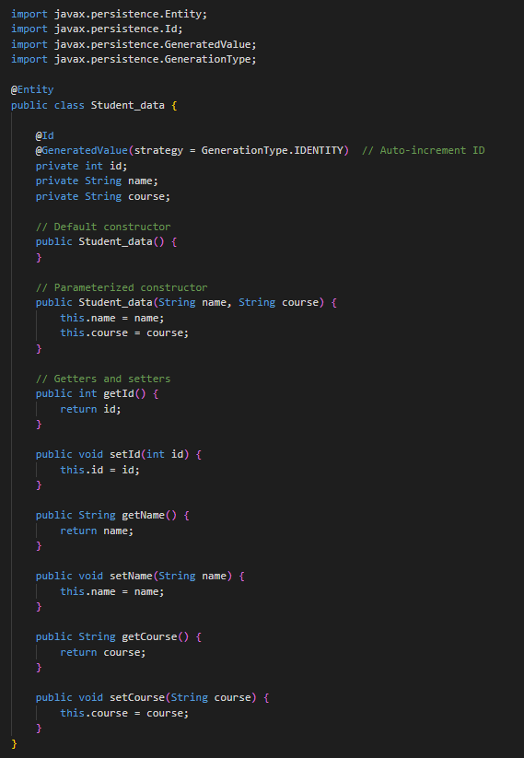
(Student_data.java)

Slide 5
I would like to inform you that I am utilizing the same maven project to run all the hibernate code. Therefore, there is no need to create separate files for student_data.java, pom.xml, and hibernate.cfg.xml

Slide 6
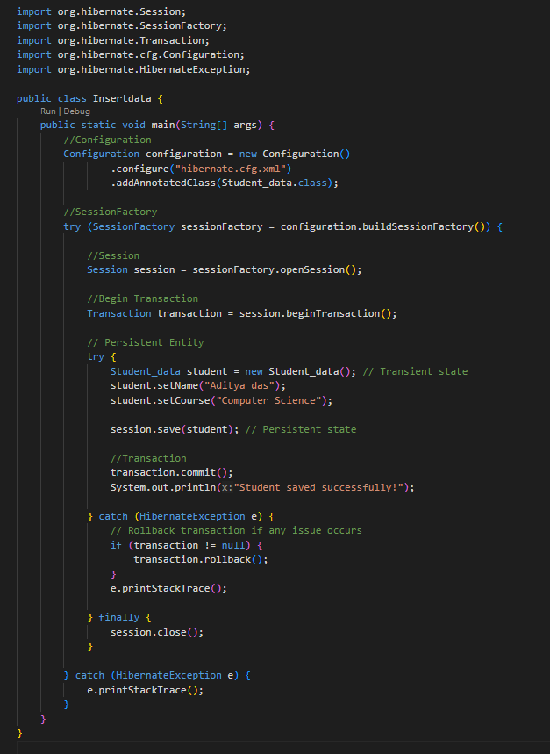
(Insertdata.java)

Slide 7
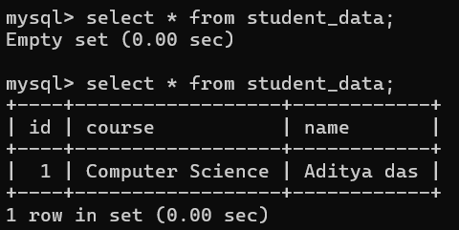
Output Insertdata.java
Terminal Output:-
MYSQL Output:-

Slide 8
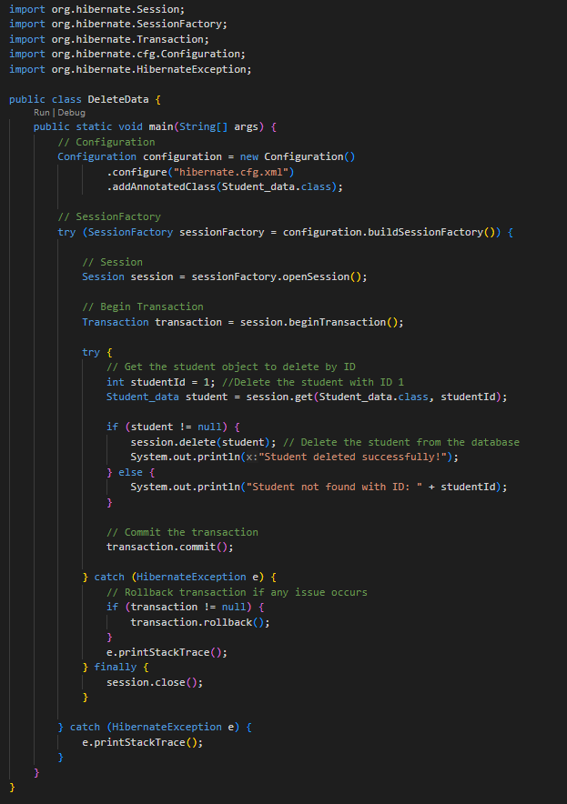
(DeleteData.java)

Slide 9
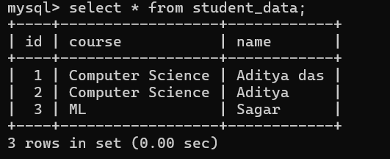
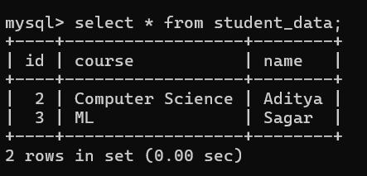
Output DeleteData.java
Terminal Output:-
MYSQL Output:-
MYSQL Output (Before)
MYSQL Output (After)

Slide 10
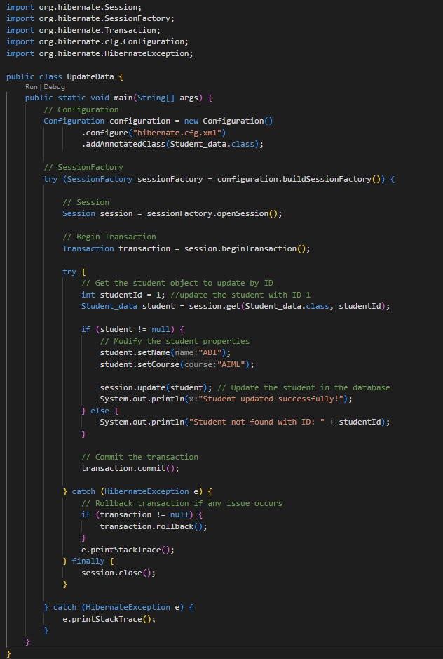
(UpdateData.java)

Slide 11
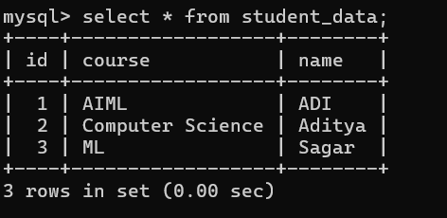
Output UpdateData.java
Terminal Output:-
MYSQL Output:-
MYSQL Output (Before)
MYSQL Output (After)

Slide 12
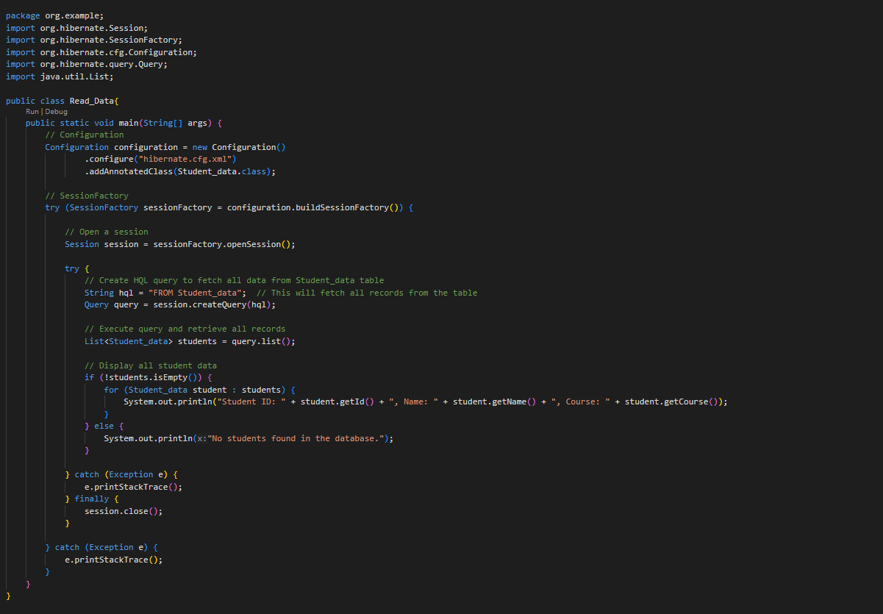
(Read_Data.java)

Slide 13
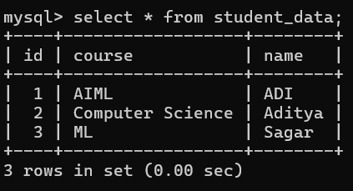
Output ReadData.java
Data in MYSQL :-
Terminal Output:-

Slide 14
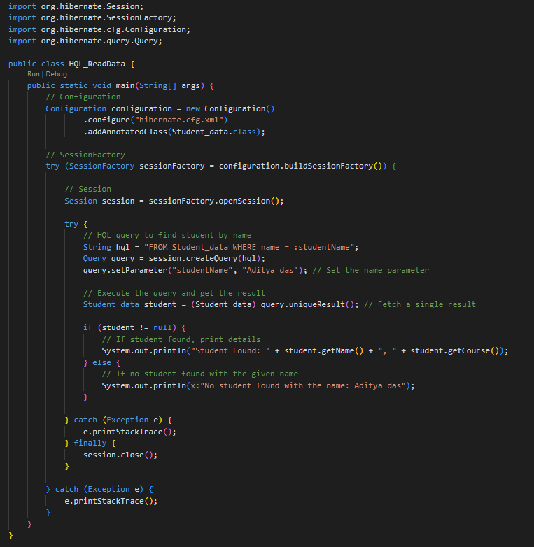
(HQL_ReadData.java)

Slide 15
Output HQL_ReadData.java
Data in MYSQL :-
Terminal Output (name present not in database):-
Terminal Output (name present in database):-

